Slide 1
Level Promotion Adjustment
Xun Liu 11-27-2017

Slide 2
Agenda
Why Routing need Level Promotion
What’s FC & FC Promotion Algorithm
What’s the issue for FC
Adjustment

Slide 3
Route Planning –
G
Dijkstra
Bidirectional Dijkstra
u
T
t
s
G
u
T_{f}
T_{b}
t
s
Notes:
Dijkstra – uses efficient priority queue to find next vertex to include into T; maintain for each vertex tentative distance
Bidirectional Dijkstra:
μ initially ∞, update when relaxing eges
next_{f} + next_{b} are the distance to the next vertices to be included in T_{f} and T_{b}
Correctness of termination: The shortest path p has length≤μ and contains an edge (v,w), where v is in T_{f}, but w has distance ≥next_{f}. But then distance w to t is ≤μ-next_{f}≤next_{b} and w must be in T_{b}, i.e. the edge (v,w) has been relaxed to dist(p) when v∈T_{f} and w∈T_{b}

Slide 4
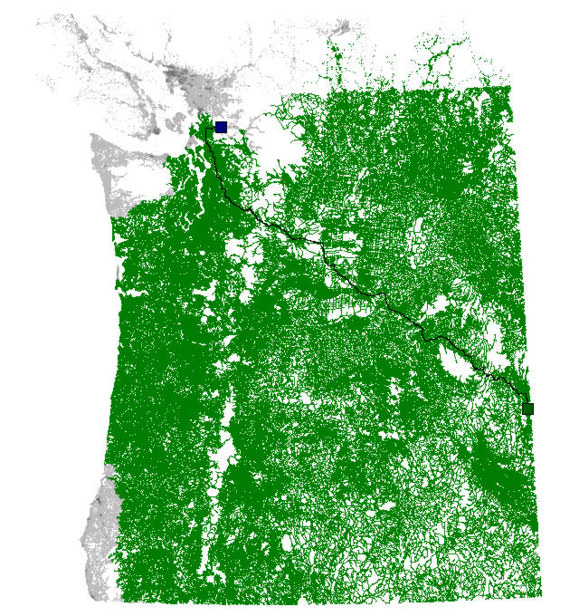
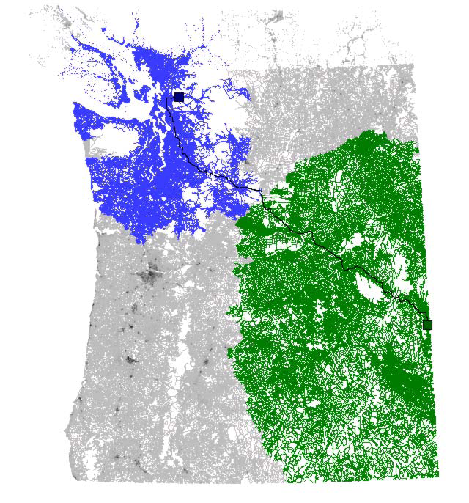
Dijkstra vs Bidirectional Dijkstra
http://www.cs.princeton.edu/courses/archive/spr06/cos423/Handouts/EPP%20shortest%20path%20algorithms.pdf
Notes:
Bidirectional Dijkstra (example area Washington state)
http://www.cs.princeton.edu/courses/archive/spr06/cos423/Handouts/EPP%20shortest%20path%20algorithms.pdf

Slide 5
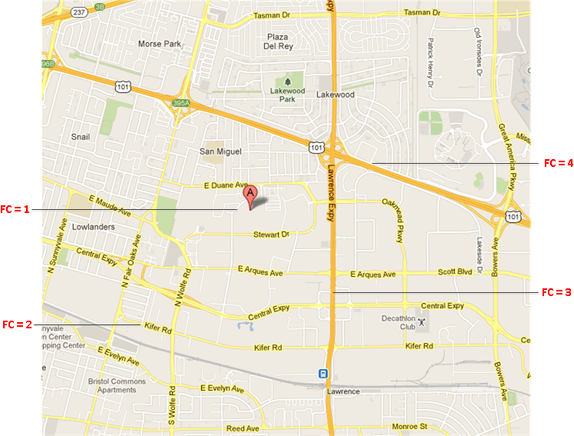
FC – illustration
Notes:
5
These roads allow for high volume, maximum speed traffic movement between and through major metropolitan areas. There are very few, if any, speed changes. Access to the road is usually controlled.
4
These roads are used to channel traffic to Main Roads for travel between and through cities in the shortest amount of time. There are very few, if any, speed changes.
3
These roads interconnect FC 4 Roads and provide a high volume of traffic movement at a lower level of mobility than FC 4.
2
These roads provide for a high volume of traffic movement at moderate speeds between neighborhoods. These roads connect with higher Priority to collect and distribute traffic between neighborhoods.
1
These roads' volume and traffic movements are below the level of any other functional class

Slide 6
FC roads distribution
FC value | Edge Count | Percent
1 | 38,342,700 | 81.63%
2 | 5,384,555 | 11.46%
3 | 1,810,361 | 3.85%
4 | 1,012,161 | 2.15%
5 | 417,404 | 0.889%
Total Edge Count | 46,967,181
HERE NA 17Q2 statistics data

Slide 7
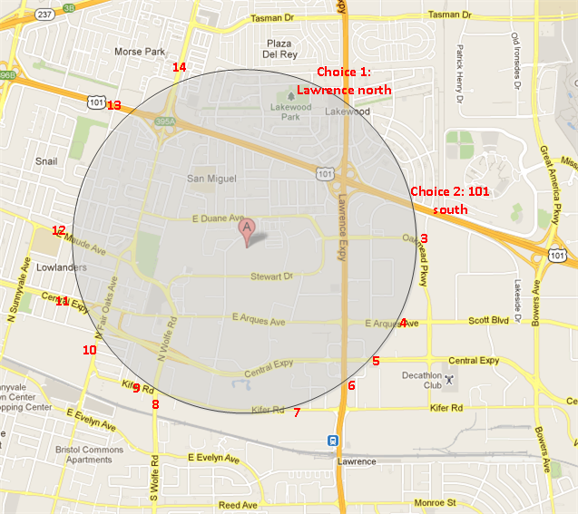
Level promote strategy - Count choices
FC keeps a count of node choices in the priority queue for each level, if the choices after level promotion reach a threshold (current is 40), then it is safe to promote
The choices threshold controls the acceleration of the routing exploration. As it becomes smaller, the exploration gets more accelerated, and the route calculation tends to become faster, but the probability of resulting in a less optimal route also becomes greater.

Slide 8
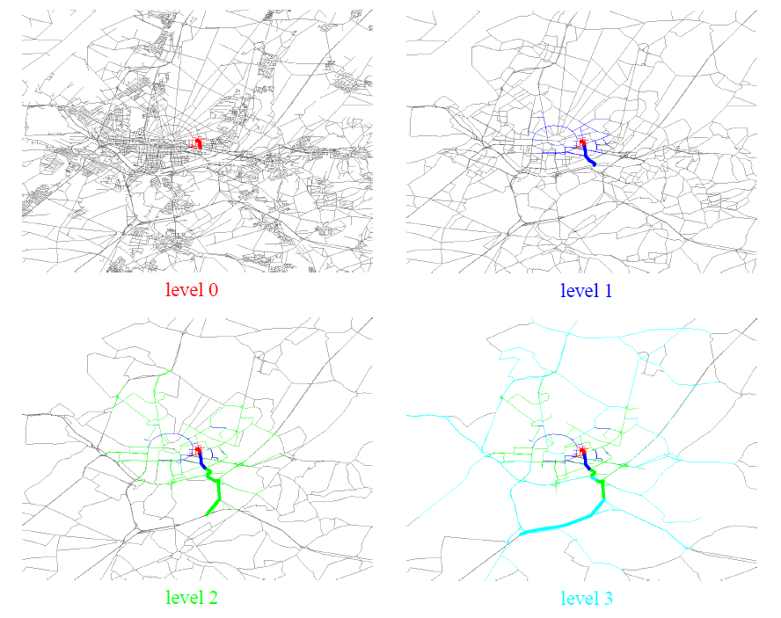
FC search space illustration

Slide 9
PROS of FC
SIMPLE
No Need Pre-processing
No Need Additional data

Slide 10
Cons of FC
No mathematical guarantee for best result (arguable about “best”)
FC algorithm depends on FC attribute quality
As static data, FC could not handle changes like avoid toll/remove certain segments/traffic jam

Slide 11
Avoid Toll
Case 1
Case 2

Slide 12
Avoid Toll
Problem analysis: low function class in the middle caused connectivity of graph is broken
Strategy: F.A.I
Expectation: Just improve long route calculation in certain percentage, adjusting only affect certain model such as avoid toll, have strategy to balance edge be adjusted and quality

Slide 13
How to Adjust using TDK
Graph exploring
Challenge of long route calculation
Challenge of processing time
Challenge of distribute calculation

Slide 14
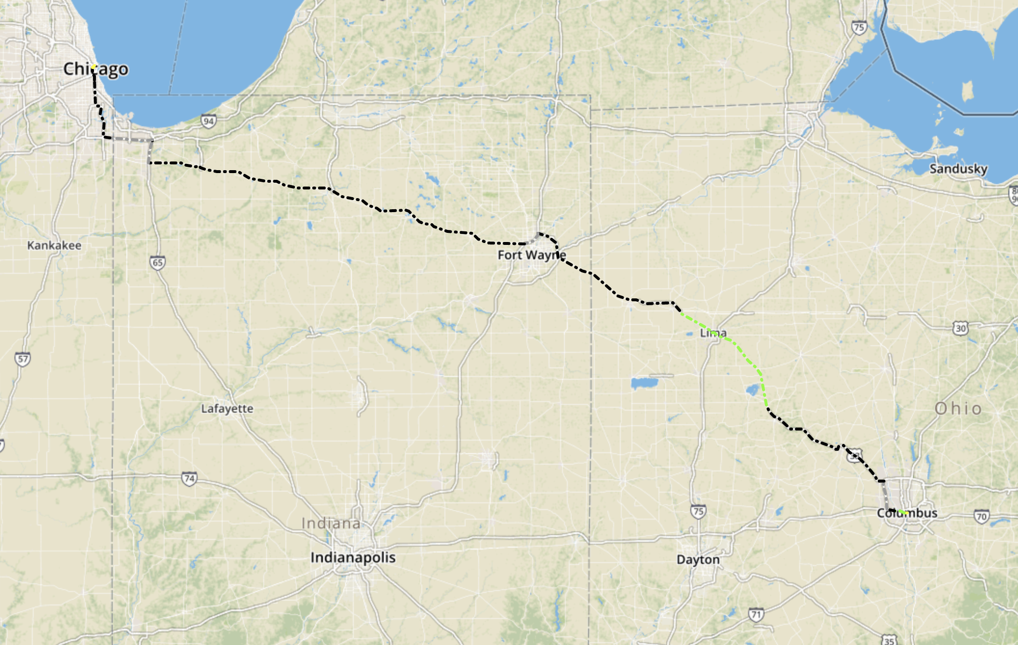
Columbus_to_Chicago
Notes:
http://hqd-ssdpostgis-07.mypna.com/webtool/case_viewer.py

Slide 15
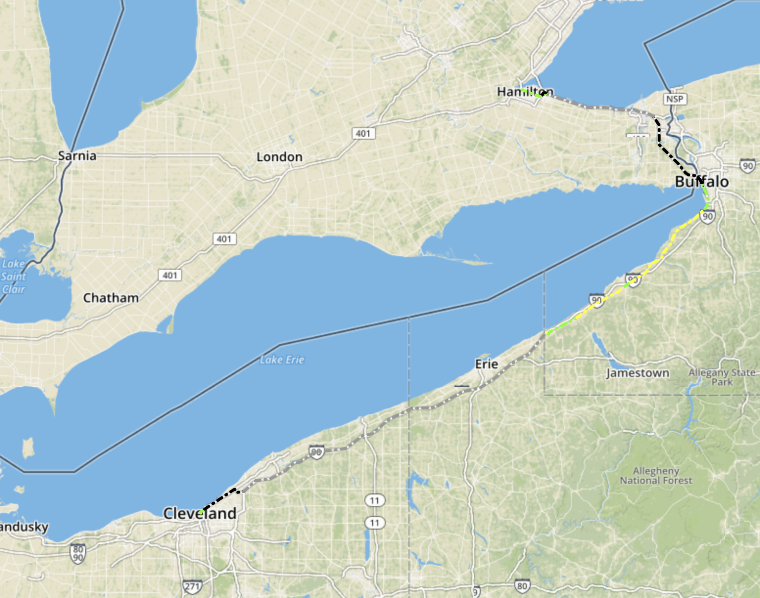
Cleveland_to_Hamilton

Slide 16
The end, thanks

Slide 17
FC roads distribution
FC value | Edge Count | Percent
1 | 26,393,008 | 92.26%
2 | 1,549,488 | 5.42%
3 | 437,110 | 1.53%
4 | 181,505 | 0.63%
5 | 45,776 | 0.16%
Total Edge Count | 28,606,887
NT NA 2006 statistics data

